Slide 1
Fundamental Models in Distributed Systems

Slide 2
1. Interaction Model
Core Concept: Processes communicate via messages over a network, focusing on communication and coordination.
  Challenges:
    Latency: Delay in message transmission (e.g., network congestion, OS load).
    Bandwidth: Shared network capacity limits data throughput.
    Jitter: Variable delays in message delivery (critical for real-time systems like video streaming).
    Clock Drift: Physical clocks across nodes diverge over time, complicating event ordering

Slide 3
1. Interaction Model
Time Models:
Synchronous Systems:
    Bounded process execution time, message delays, and clock drift (e.g., real-time systems).
    Enables reliable timeouts and fault detection.
    Example: Air traffic control systems with strict timing guarantees.
    Clock Drift: Physical clocks across nodes diverge over time, complicating event ordering

Slide 4
1. Interaction Model
Time Models:
Asynchronous Systems:
    No timing guarantees (e.g., the Internet).
    Processes/messages may take arbitrary time, complicating coordination.
    Example: Web servers handling variable client requests.

Slide 5
1. Interaction Model
Event Ordering:
Logical Clocks (Lamport, 1978):
  Assigns sequence numbers to events to infer causality without synchronized clocks.
  Example: Email replies ordered by logical dependencies (e.g., Re: Meeting).

Slide 6
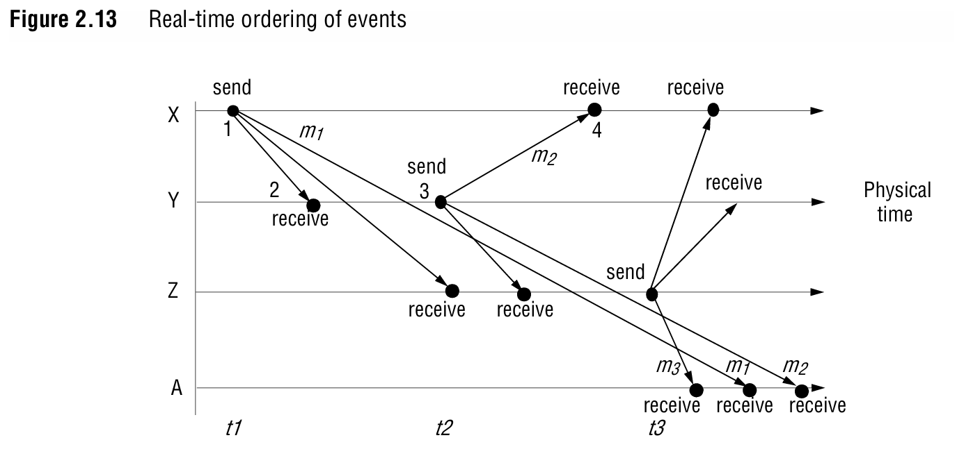

Slide 7
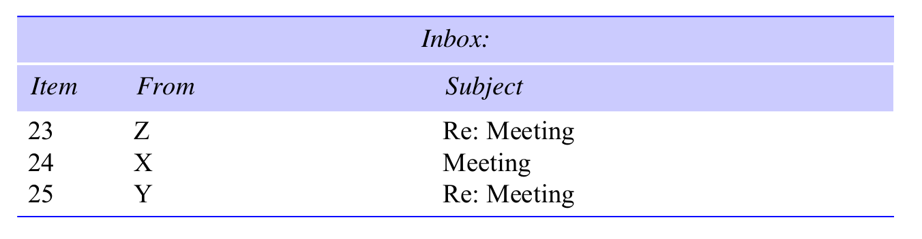

Slide 8
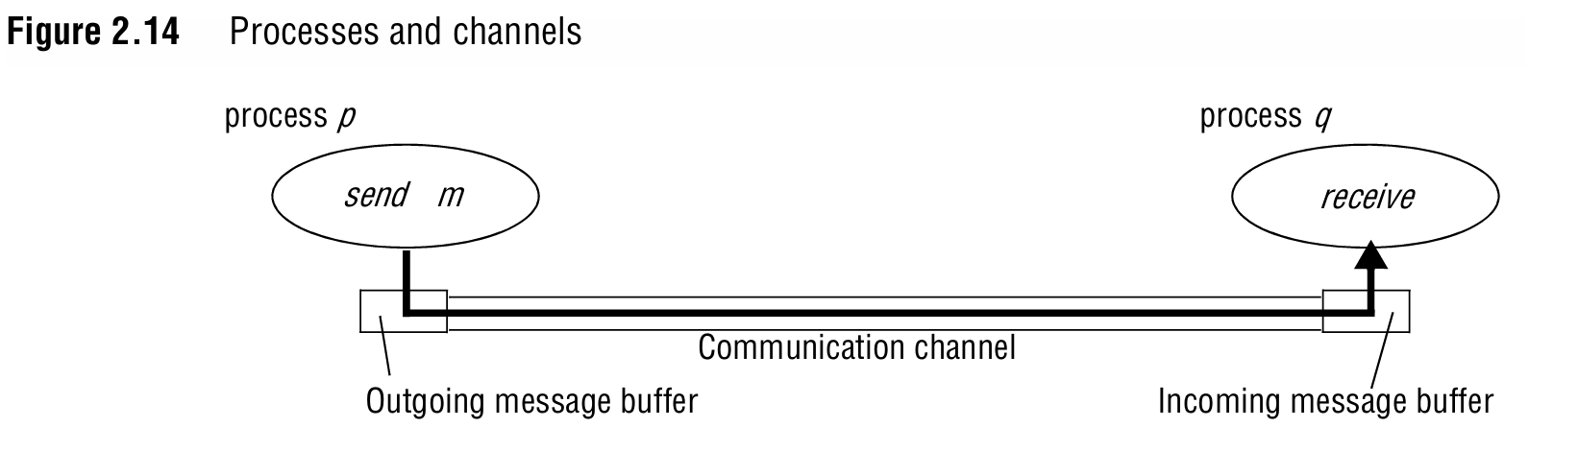

Slide 9
2. Failure Model
Types of Failures:
Omission Failures:
  Process Crash: Halts indefinitely (detected via timeouts in synchronous systems).
  Message Loss: Dropped due to buffer overflow or network errors.
  Fail-Stop: Clean crash detectable by others (e.g., synchronized systems).

Slide 10
2. Failure Model
Arbitrary (Byzantine) Failures:
  Processes/channels behave unpredictably (e.g., corrupting data or sending false messages).
  Example: A compromised server returning incorrect financial data.
Timing Failures (Synchronous Systems):
  Missed deadlines (e.g., slow process execution or message delays).
  Example: Video conferencing with laggy audio/video.

Slide 11
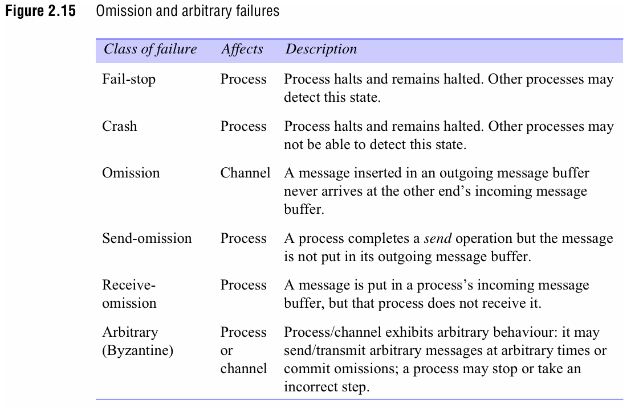

Slide 12
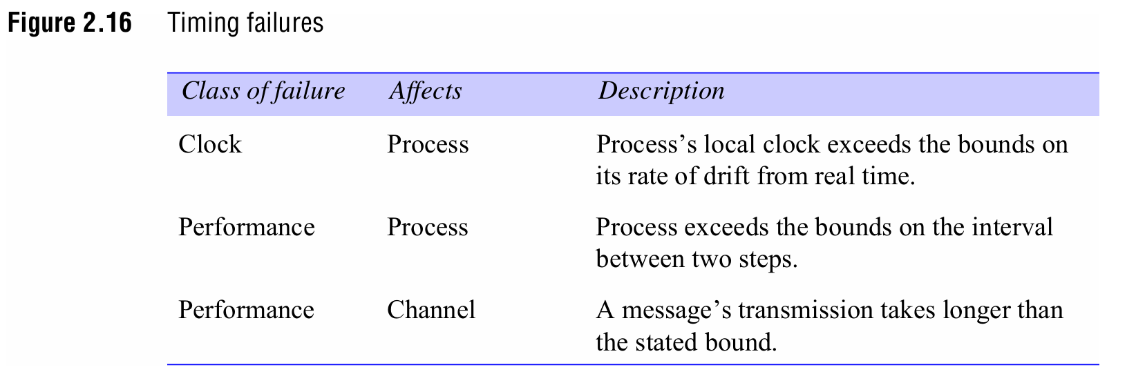

Slide 13
2. Failure Model
Mitigation:
Masking Failures:
  Redundancy: Replicated servers to tolerate crashes.
  Checksums/Retransmission: Detect/correct message corruption or loss.
Reliable Communication:
  Validity: Guaranteed message delivery.
  Integrity: No duplication or tampering (e.g., sequence numbers, encryption).

Slide 14
3. Security Model
Threats:
The Enemy (Adversary): Can intercept, forge, or replay messages.
  Spoofing: Fake identities (e.g., unauthorized user accessing a mailbox).
  Tampering: Altering message contents (e.g., changing a bank transfer amount).
  Replay Attacks: Resending old messages (e.g., duplicate financial transactions).

Slide 15
3. Security Model
Defences:
Cryptography:
  Encryption: Scramble data using keys (e.g., AES, RSA).
  Authentication: Verify identities via shared secrets/digital certificates.

Slide 16
3. Security Model
Defences:
Secure Channels:
  Privacy: Encrypted messages (e.g., SSL/TLS for web traffic).
  Integrity: Tamper-proof via hashing (e.g., HMAC).
  Non-repudiation: Proof of message origin (e.g., digital signatures).

Slide 17
3. Security Model
Defences:
Access Control:
  Principals: Users/processes with verified identities.
  Authorization: Rights-based access to objects (e.g., read/write permissions).

Slide 18
3. Security Model
Additional Threats:
Denial of Service (DoS): Overload systems to disrupt service (e.g., flooding a server).
Mobile Code: Malware in downloaded scripts (e.g., email attachments).
Threat Modelling:
Analyse risks (e.g., data breaches, service disruptions).
Balance security measures (e.g., encryption overhead vs. risk tolerance).

Slide 19
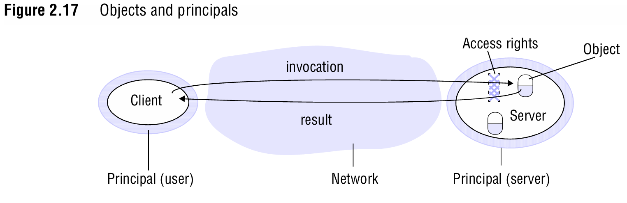

Slide 20
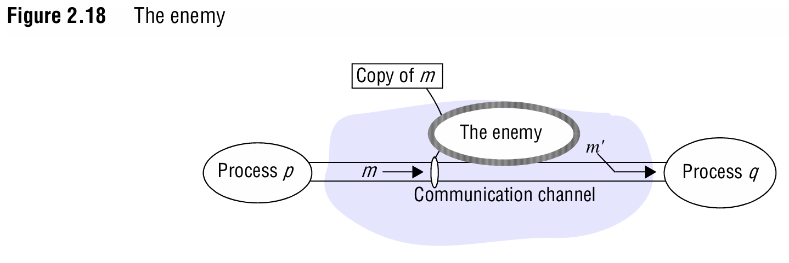

Slide 21
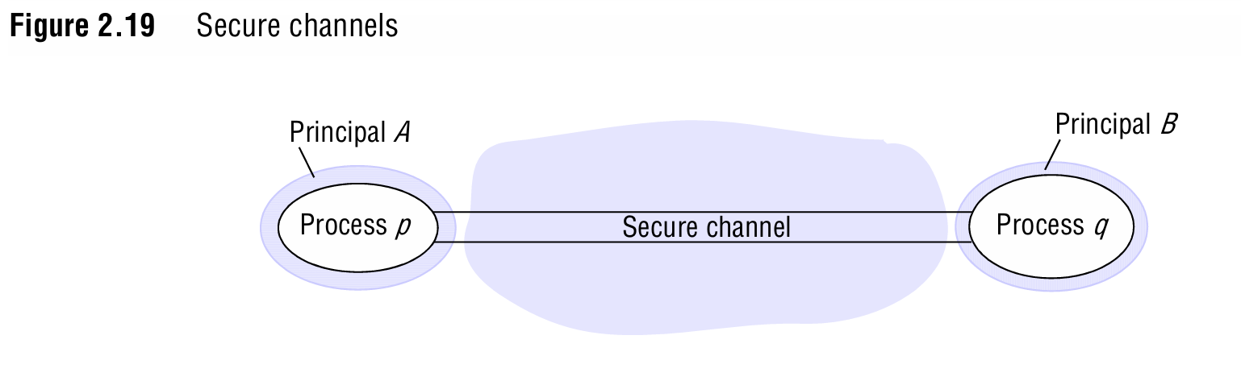

Slide 22
Key Takeaways
Interaction Models address timing and coordination challenges.
Failure Models classify and mitigate crashes, message loss, and Byzantine behavior.
Security Models protect against unauthorized access, tampering, and spoofing via cryptography and access control.
Trade-offs: Synchronous systems offer reliability but are complex; asynchronous systems are flexible but unpredictable. Security measures must balance cost and risk.

Slide 23
Real-World Applications
  VPNs/SSL: Secure channels for encrypted communication.
  Blockchain: Byzantine fault tolerance for decentralized consensus.
  Cloud Systems: Redundancy and failover to mask hardware failures.

